Slide 1
Indeed SEB with Java and React
Feb 12, 2024

Slide 2
The CLI (Command Line Interface)
Learning Objectives
Define and explain the strengths and weaknesses of GUIs and CLIs
Learn how to access the terminal and break down its components
Describe the file system and how it relates to the CLI
Introduce common commands and list unsafe ones
Learn how to find more information on using commands
Introduce Bash and how to customize the command line
Notes:
Purpose: Headline for Spring.

Slide 3
The CLI (Command Line Interface)
Framing
The majority of our interactions with computers is through a graphical user interface, or a GUI. A GUI is a great tool, it adds a level of user experience that allowed computers to become more popular and mainstream.
While the GUI is perfect for the average computer user, there are drawbacks for power users:
Some of those hindrances include:
GUI's can be slow
GUI's can be resource intensive, causing the gui to freeze which means you could lose data or it can cause other applications to stop working
GUI's lack flexibility, you can only use a gui for it’s intended purpose
GUI's require manual effort, pointing and clicking, require that you take your hands off the keyboard
Notes:
Purpose: Headline for Spring.

Slide 4
The CLI (Command Line Interface)
What is the Command Line Interface or CLI
A text-based way of interacting with your computer, that gives you more abilities than a GUI has. Except with a higher learning curve.
The CLI works by typing commands (running programs) into a terminal and the computer executes those commands or gives you a fairly descriptive error regarding why it did not work.
You can create files, you can move between directories, you can connect to remote machines, you can pull code from a repository, you can scan ports, you can send http requests.
Notes:
Purpose: Headline for Spring.

Slide 5
The CLI (Command Line Interface)
Benefits of the CLI
Power/Speed. Most tasks can be completed faster with the cli. Features like tab completion, command history (hitting the up arrow in your terminal) contribute to this.
Precision. Each command does only one thing and we can read them and understand what they do before we run them.
Repeatability / Scriptability. These commands can be saved, reused by others. What you did during Installfest was run a script that we shared with you!
Tools. There are a lot of open source tools that you can use on the cli, you can install them with cli package managers like Advanced Packaging Tool (apt) on linux or homebrew on macOS. Because each tool does one specific thing, it is possible to chain multiple tools together to automate processes.
Debugging. The errors are better, the errors that you get from a GUI can be unhelpful while cli errors are generally more thought out and descriptive.
Notes:
Purpose: Headline for Spring.

Slide 6
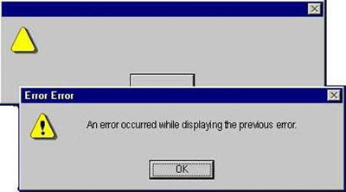
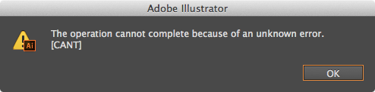
The CLI (Command Line Interface)
Benefits of the CLI

Slide 7

The CLI (Command Line Interface)
Benefits of the CLI
Notes:
Purpose: Headline for Spring.

Slide 8
The CLI (Command Line Interface)
CLI Basics
How do we get at this text-based interface from our GUI desktop?
We run what's called a terminal application (also often referred to as a terminal emulator). The default on OSX is Terminal.app.
When you open a new Terminal window, the Terminal app will call a program called a shell.
A shell is a program that takes commands, passes them to the operating system and returns any output or errors.
Notes:
Purpose: Headline for Spring.

Slide 9
The CLI (Command Line Interface)
CLI Basics
First, open Terminal by clicking the icon on your dock, finding the application in Applications > Utilities > Terminal, or using Spotlight (⌘ + SPC)
Typing a random string of characters and hitting enter will produce a message -bash: <your-random-string>: command not found
What is a command?
A command is a program. Some come built into the shell and provide the basics for interacting with the operating system and some are written by programmers (like you!) to provide further functionality.
Notes:
Purpose: Headline for Spring.

Slide 10
Question: What are some basic commands that you've covered previously or already know of?

Slide 11
The CLI (Command Line Interface)
File System
In the next section of this lesson, we're going to work through a couple of commands that you'll end up using almost every day as a developer.
The commands can be divided into two kinds of tasks:
Navigating around the file system
Working with files and directories.
Notes:
Purpose: Headline for Spring.

Slide 12
The CLI (Command Line Interface)
Navigating the File System
The first set of commands we'll cover are for navigating: getting from one directory to another.
You may have seen these commands before (maybe in the prework):
command | definition
pwd | print working directory
ls | list files and directories
cd | change directory
Notes:
Purpose: Headline for Spring.

Slide 13
The CLI (Command Line Interface)
Navigating the File System
If we're inside the terminal and we want to travel through our file system to a specific directory we first need to know where we are. That's what we use pwd for: printing the directory we're in currently.
We use ls for listing all the files we can work with directly and the directories we can move to.
To move from our current directory to another directory, we use the cd command. cd moves us from our current directory to another directory that we supply a path to.
Notes:
Purpose: Headline for Spring.

Slide 14
The CLI (Command Line Interface)
Absolute vs Relative
A relative path is similar to giving someone directions to a destination from their current location. Where is General Assembly? Two blocks up 15th street from where you are now.
An example of an absolute path to General Assembly could be 1133 15th St NW, 8th Floor, Washington, DC 20005 or a longitude and latitude(38.9048728, -77.0340283).
An absolute path is comparable to giving someone the direct location from a universally known starting point. On the command line that known starting point is the root directory.
Notes:
Purpose: Headline for Spring.

Slide 15
Question: When we open a terminal window for the first time, what directory are we in?

Slide 16
The CLI (Command Line Interface)
Home Directory
When we open a terminal window for the first time, we are in the home directory.
Notes:
Purpose: Headline for Spring.

Slide 17
Go Explore: 5 mins Using the commands you've learned, go explore your file system for a few minutes. When you open a new terminal window, where in the file system are you? What do you see? Compare that to opening a new window in Finder

Slide 18
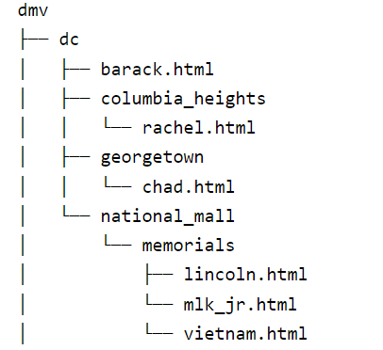
The CLI (Command Line Interface)
Let do Exercise Together
Notes:
Purpose: Headline for Spring.

Slide 19
Break: 15 mins

Slide 20
The CLI (Command Line Interface)
Working with Files and Directories
The commands we'll be covering next are:
Command | Description
mkdir | make a new directory
rmdir | remove a directory
touch | create a new file
rm | remove a file
mv | move a file or directory
cp | copy a file or directory
Notes:
Purpose: Headline for Spring.

Slide 21
The CLI (Command Line Interface)
Command Syntax
Commands generally consist of three parts
Command
Options
Arguments
The Command is the first word you type into the CLI (e.g. ls, cd, or touch). Think of it as the "verb" which indicates what we want to do.
Notes:
Purpose: Headline for Spring.

Slide 22
The CLI (Command Line Interface)
Command Syntax
Options and Arguments
- rm –r folder - here –r is an option and folder is an argument
- touch abc.html – no option only abc.html as an argument
Sometimes options can be combined like
- rm –rf folder - here –rf is a combination of r and f options
Notes:
Purpose: Headline for Spring.

Slide 23
The CLI (Command Line Interface)
Output and Side Effects
Some commands have output, which is displayed on the screen for us to see. Examples of commands that have output are...
pwd
ls
brew install tree.
Other commands' primary purpose is to execute some side-effect, or in other words, to make some change that isn't necessarily printed in the Terminal after hitting enter.
Notes:
Purpose: Headline for Spring.

Slide 24
Question: What's an example of a command with no output we've already seen?

Slide 25
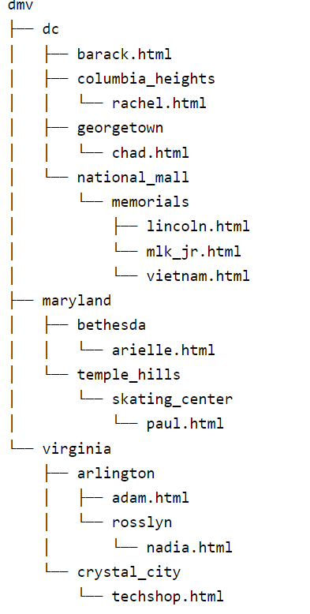
The CLI (Command Line Interface)
You do Exercise
Notes:
Purpose: Headline for Spring.

Slide 26
The CLI (Command Line Interface)
Getting Help
There are three general ways to get help with a command.
Add --help or --h to the end of the command (e.g., brew --help).
Use the manual or man - tool (e.g., man brew).
For a really fun time look up the manual for man (man man).
Google!
Notes:
Purpose: Headline for Spring.

Slide 27
The CLI (Command Line Interface)
Unsafe Commands
Sudo
sudo -- or "super user do" -- runs the command that follows as the super user (i.e., 'root' or 'admin’).
That means your computer will not prevent you from running the command and may not even confirm if this is what you actually want to do. This is of particular concern when the command may have destructive effects.
Rm
rm or "remove" -- deletes files with no confirmation. There is no trash to recover removed files from. So use rm with caution.
You should especially use rm -rf with caution.
Notes:
Purpose: Headline for Spring.

Slide 28
Question: 1. What does rm -rf do? 2. Why can mv or “move” also be unsafe?

Slide 29
The CLI (Command Line Interface)
Wrapping up!
The commands we've covered in this lesson will probably account for 80% of your CLI usage.
On the one hand, that means that learning them well and getting comfortable is really important;
on the other hand, it's not a big universe of commands to learn and memorize.
Regardless of how much experience with the command line you have coming in to this class, your next step should be to get really comfortable with it - we're going to spend a lot of time in the command line over the next 16 weeks.
Notes:
Purpose: Headline for Spring.

Slide 30
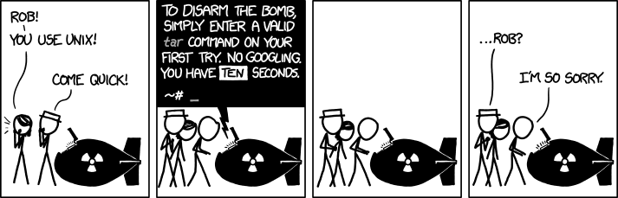
The CLI (Command Line Interface)
Command Syntax
Notes:
Purpose: Headline for Spring.

Slide 31

ANY QUESTIONS?

